Slide 1

Introduction
To Image Comparison
A DIFFERENT PERSPECTIVE

Slide 2
INDUSTRY
VS
ACADEMIA

Slide 3
Interdiscipline

Slide 4
MACHINE
LEARNING

Slide 5
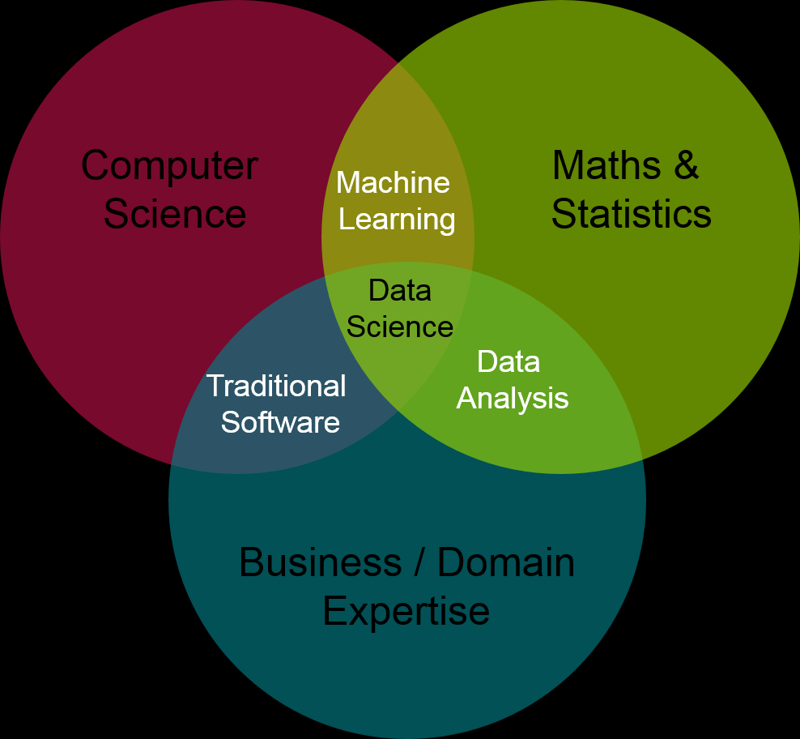

Slide 6

MATRIX
A rectangular array of numbers, symbols or expressions arranged in rows and columns
$$\begin{matrix}1 & 0 & 1 \\ 0 & 1 & 0 \\ 1 & 0 & 1\end{matrix}$$

Slide 7
What is A DIGITAL IMAGE
There is a relationship between digital images and matrices. Digital images to a computer is presented by pixels matrix.
A grayscale digital image is a matrix whose element consists of a whole number which has a value between 0 to 255
On the other hand, colored digital image are represented by a number of matrices depending on the color model chosen.
Additive
  RGB Model requires three matrices, representing each color channel (red, green, blue)
  Subtractive
  CMYK Model requires four matrices, representing Cyan, Magenta, Yellow and Key (Black)

Slide 8

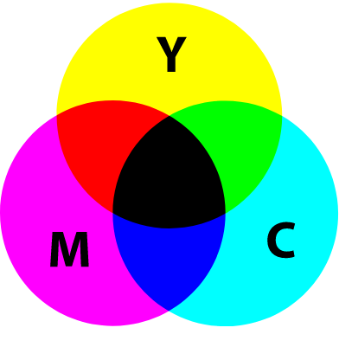
What is A DIGITAL IMAGE
There is a relationship between digital images and matrices. Digital images to a computer is presented by pixels matrix.
A grayscale digital image is a matrix whose element consists of a whole number which has a value between 0 to 255
On the other hand, colored digital image are represented by a number of matrices depending on the color model chosen.
Additive
  RGB Model requires three matrices, representing each color channel (red, green, blue)
  Subtractive
  CMYK Model requires four matrices, representing Cyan, Magenta, Yellow and Key (Black)

Slide 9
Image Analysis
Extraction of meaningful information from images, mainly digital images through the means of digital processing techniques.
Digital image processing is a field in Computer Science and a subcategory of Digital Signal Processing (DSP)

Slide 10
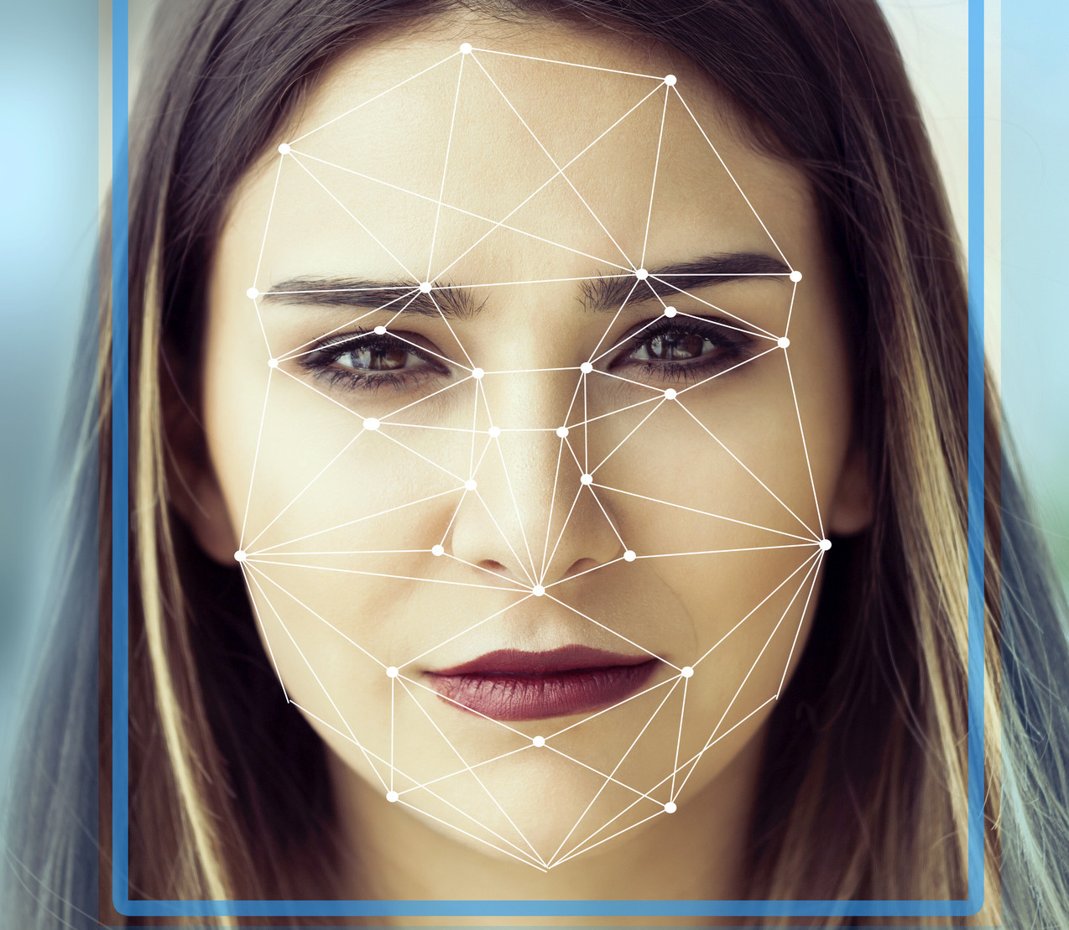
A little depth explanation of how it is possible

Slide 11

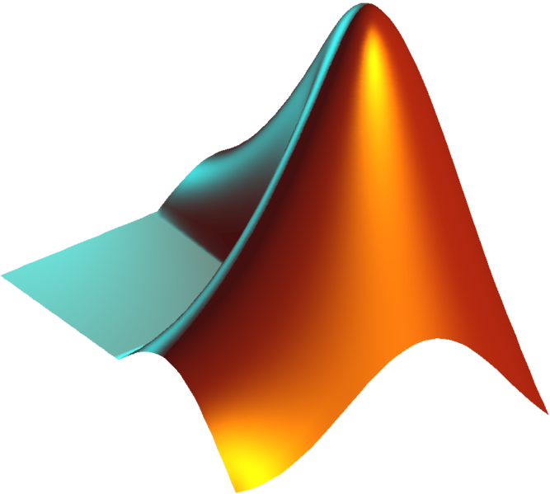
Matlab
Octave

Slide 12
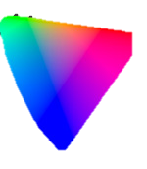
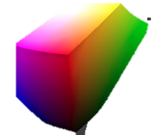
Color Spaces
Organization of colors
It represents what a camera can see, a monitor can display or a printer can print, and etc.
CIE u’v’
RGB

Slide 13
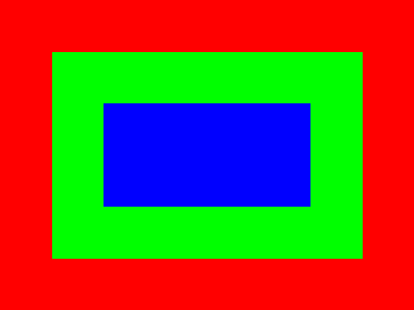
RGB Example (6x8)
255 | 255 | 255 | 255 | 255 | 255 | 255 | 255
255 | 0 | 0 | 0 | 0 | 0 | 0 | 255
255 | 0 | 0 | 0 | 0 | 0 | 0 | 255
255 | 0 | 0 | 0 | 0 | 0 | 0 | 255
255 | 0 | 0 | 0 | 0 | 0 | 0 | 255
255 | 255 | 255 | 255 | 255 | 255 | 255 | 255
0 | 0 | 0 | 0 | 0 | 0 | 0 | 0
0 | 255 | 255 | 255 | 255 | 255 | 255 | 0
0 | 255 | 0 | 0 | 0 | 0 | 255 | 0
0 | 255 | 0 | 0 | 0 | 0 | 255 | 0
0 | 255 | 255 | 255 | 255 | 255 | 255 | 0
0 | 0 | 0 | 0 | 0 | 0 | 0 | 0
0 | 0 | 0 | 0 | 0 | 0 | 0 | 0
0 | 0 | 0 | 0 | 0 | 0 | 0 | 0
0 | 0 | 255 | 255 | 255 | 255 | 0 | 0
0 | 0 | 255 | 255 | 255 | 255 | 0 | 0
0 | 0 | 0 | 0 | 0 | 0 | 0 | 0
0 | 0 | 0 | 0 | 0 | 0 | 0 | 0

Slide 14
CMYK Example (6x8)
81 | 81 | 81 | 81 | 81 | 81 | 81 | 81
81 | 145 | 145 | 145 | 145 | 145 | 145 | 81
81 | 145 | 41 | 41 | 41 | 41 | 145 | 81
81 | 145 | 41 | 41 | 41 | 41 | 145 | 81
81 | 145 | 145 | 145 | 145 | 145 | 145 | 81
81 | 81 | 81 | 81 | 81 | 81 | 81 | 81
90 | 90 | 90 | 90 | 90 | 90 | 90 | 90
90 | 54 | 54 | 54 | 54 | 54 | 54 | 90
90 | 54 | 240 | 240 | 240 | 240 | 54 | 90
90 | 54 | 240 | 240 | 240 | 240 | 54 | 90
90 | 54 | 54 | 54 | 54 | 54 | 54 | 90
90 | 90 | 90 | 90 | 90 | 90 | 90 | 90
240 | 240 | 240 | 240 | 240 | 240 | 240 | 240
240 | 34 | 34 | 34 | 34 | 34 | 34 | 240
240 | 34 | 110 | 110 | 110 | 110 | 34 | 240
240 | 34 | 110 | 110 | 110 | 110 | 34 | 240
240 | 34 | 34 | 34 | 34 | 34 | 34 | 240
240 | 240 | 240 | 240 | 240 | 240 | 240 | 240

Slide 15
CMYK Example (6x8)
81 | 81 | 81 | 81 | 81 | 81 | 81 | 81
81 | 145 | 145 | 145 | 145 | 145 | 145 | 81
81 | 145 | 41 | 41 | 41 | 41 | 145 | 81
81 | 145 | 41 | 41 | 41 | 41 | 145 | 81
81 | 145 | 145 | 145 | 145 | 145 | 145 | 81
81 | 81 | 81 | 81 | 81 | 81 | 81 | 81
90 | 90 | 90 | 90 | 90 | 90 | 90 | 90
90 | 54 | 54 | 54 | 54 | 54 | 54 | 90
90 | 54 | 240 | 240 | 240 | 240 | 54 | 90
90 | 54 | 240 | 240 | 240 | 240 | 54 | 90
90 | 54 | 54 | 54 | 54 | 54 | 54 | 90
90 | 90 | 90 | 90 | 90 | 90 | 90 | 90
Pixel
240 | 240 | 240 | 240 | 240 | 240 | 240 | 240
240 | 34 | 34 | 34 | 34 | 34 | 34 | 240
240 | 34 | 110 | 110 | 110 | 110 | 34 | 240
240 | 34 | 110 | 110 | 110 | 110 | 34 | 240
240 | 34 | 34 | 34 | 34 | 34 | 34 | 240
240 | 240 | 240 | 240 | 240 | 240 | 240 | 240

Slide 16
Color Spaces
Organization of colors
It represents what a camera can see, a monitor can display or a printer can print, and etc.
Normally printing is done on subtractive color models
  In art class, we always paint in a white canvas, and in theory, we can create a colorful painting already as long as we have a good supply of red, yellow and blue (RYB)
Projecting colors through light is done on additive color models
  The reason why we use RGB instead of CMYK or RYB (Primary Color) for stuff like monitor is because mixing light is different than mixing pigments
CIE u’v’
RGB

Slide 17
Color Spaces
RGB and CYMK are meant for different purposes.
  Because RGB is meant for display different colors using light
  While CYMK is meant to be use with pigments (for printing purposes)
It would be difficult for us to understand color perception in a digital image if we only have RGB or CYMK
Which is why there are other color spaces as well, such as a color space that is meant to mimic how humans perceive color
Such as
  CIE U’V or also known as L*U*V
CIE U’V’
RGB

Slide 18
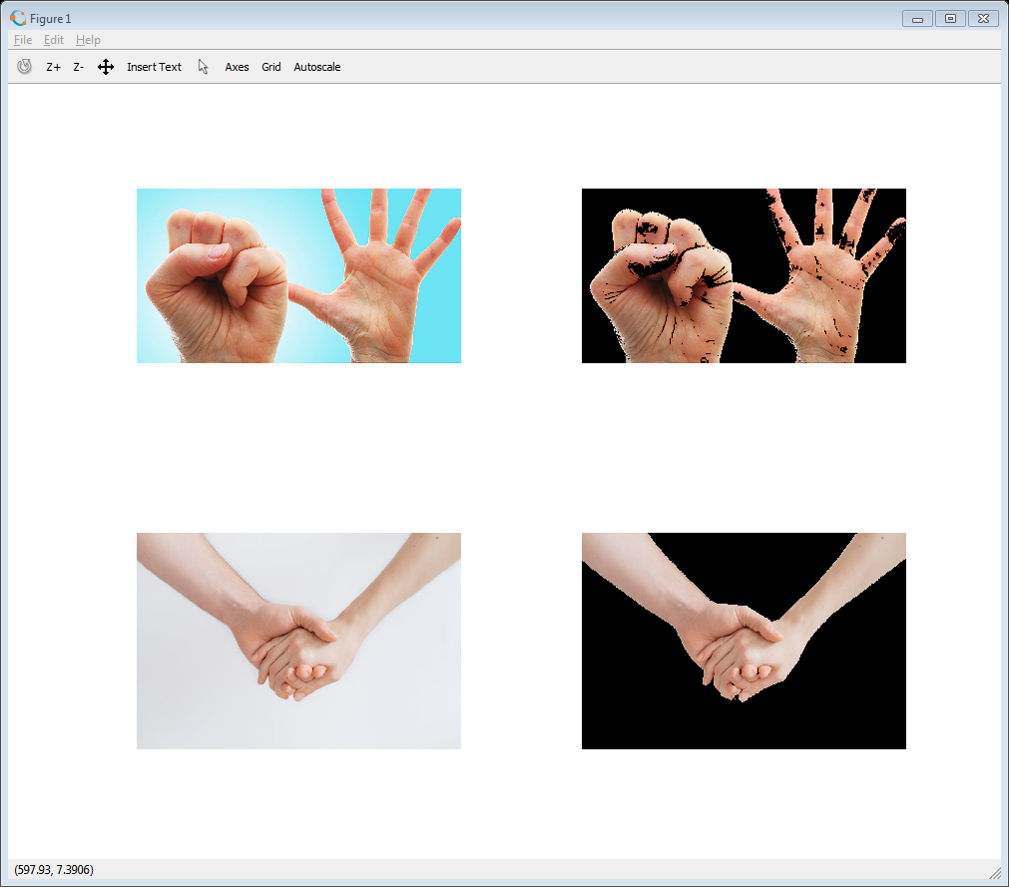
Skin Extraction

Slide 19
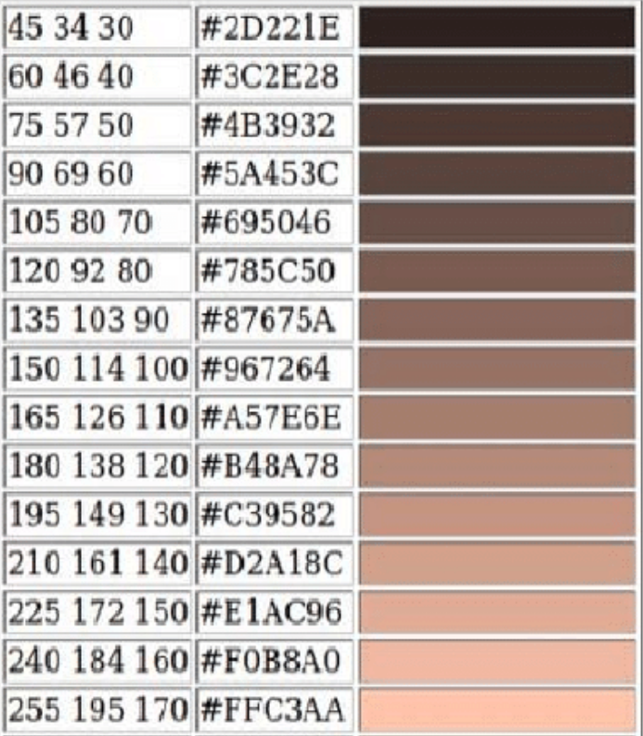
Example (Extracting “Skin” Color) RGB
Covering set of pixels of varying distances
However it is hard for us to detect the pixels with RGB alone
  Because some color values look identical to us humans in the RGB map scale but never occurs in an actual digital image

Slide 20
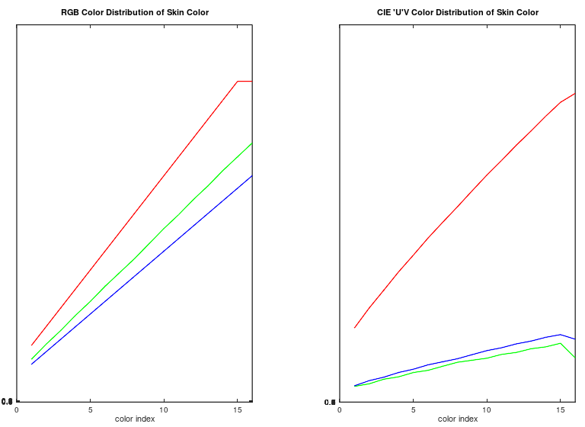

Slide 21
Example (Extracting “Skin” Color) CIE U’V’
(SLOPPY VERSION)
For extracting pixels, we can use the following baseline, instead of exact pixel values:
The L (Luminance Value) must be greater than 95
The U chromacity must have a value between 3 and 34
The V chromacity must have a value between 0 and 34

Slide 23
Sample code in Octave
pkg load image;
function [o] = skin_extract(name)
hand = imread(name);
luvhand = rgb2lab(hand);
shadowmap = luvhand(:,:,1) <= 95;
shadowmap2 = luvhand(:,:,3) > 2 & luvhand(:,:,3) < 35;
shadowmap3 = luvhand(:,:,2) > 0 & luvhand(:,:,2) < 35;
result = hand .* shadowmap2;
result = result .* shadowmap;
result = result .* shadowmap3;
o = result;
end;
imshow(skin_extract(“name of file.jpg”))

Slide 24
Histograms
The count of colors present on the image.
Represents the color distribution of an image

Slide 25
RGB Example (6x8)
255 | 255 | 255 | 255 | 255 | 255 | 255 | 255
255 | 0 | 0 | 0 | 0 | 0 | 0 | 255
255 | 0 | 0 | 0 | 0 | 0 | 0 | 255
255 | 0 | 0 | 0 | 0 | 0 | 0 | 255
255 | 0 | 0 | 0 | 0 | 0 | 0 | 255
255 | 255 | 255 | 255 | 255 | 255 | 255 | 255
0 | 0 | 0 | 0 | 0 | 0 | 0 | 0
0 | 255 | 255 | 255 | 255 | 255 | 255 | 0
0 | 255 | 0 | 0 | 0 | 0 | 255 | 0
0 | 255 | 0 | 0 | 0 | 0 | 255 | 0
0 | 255 | 255 | 255 | 255 | 255 | 255 | 0
0 | 0 | 0 | 0 | 0 | 0 | 0 | 0
0 | 0 | 0 | 0 | 0 | 0 | 0 | 0
0 | 0 | 0 | 0 | 0 | 0 | 0 | 0
0 | 0 | 255 | 255 | 255 | 255 | 0 | 0
0 | 0 | 255 | 255 | 255 | 255 | 0 | 0
0 | 0 | 0 | 0 | 0 | 0 | 0 | 0
0 | 0 | 0 | 0 | 0 | 0 | 0 | 0

Slide 26
Histograms
Color | Count
(255, 0, 0) | 24
(0, 255, 0) | 16
(0, 0, 255) | 8

Slide 27

Histogram Intersection
${SIM}_{ExactCol}\left(Q, I, i\right)=1−\frac{|NH\left(Q,i\right)−NH\left(I, i\right)|}{max[NH\left(Q,i\right), NH\left(I,i\right)]}$
Calculate the similarity of two discretized probability distributions (histograms), with possible value of the intersection lying between 0 (no overlap) and 1 (identical distributions)

Slide 28
Histograms
The count of colors present on the image.
Represents the color distribution of an image
We use this to check how the two images are:
  Similar in color distribution (if the matrix is 3 dimensions; Image is Colored)
  Similar in pixel distribution (if the matrix is 1 dimension; Image is Grayscaled)

Slide 29

Histograms
$1 − ({\frac{|24 −21|}{24}+ \frac{|16 −15 |}{16}+ \frac{|8 −10|}{10}}/3)$
1 – [(0.125 + 0.0625 + 0.2) / 3]
1 – [0.3875/3]
1 - 0.1291
0.870833 or 87% Similarity
Color | Count
(255, 0, 0) | 24
(0, 255, 0) | 16
(0, 0, 255) | 8
Color | Count
(255, 0, 0) | 21
(0, 255, 0) | 15
(0, 0, 255) | 10

Slide 30
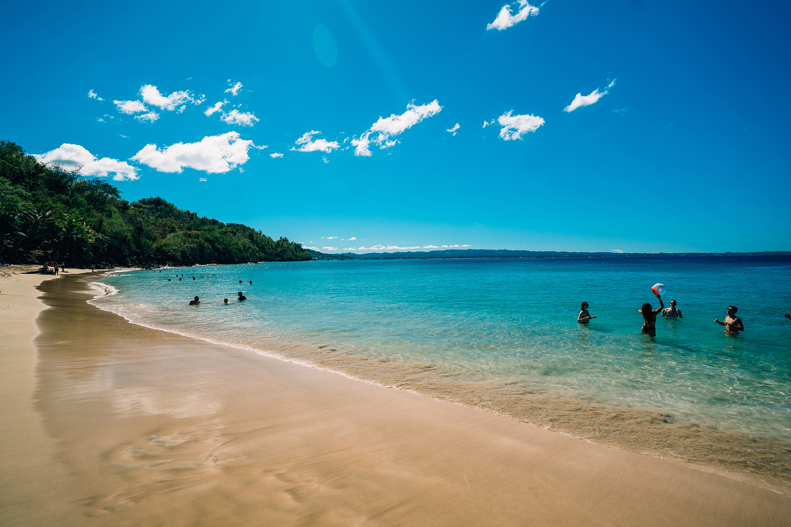
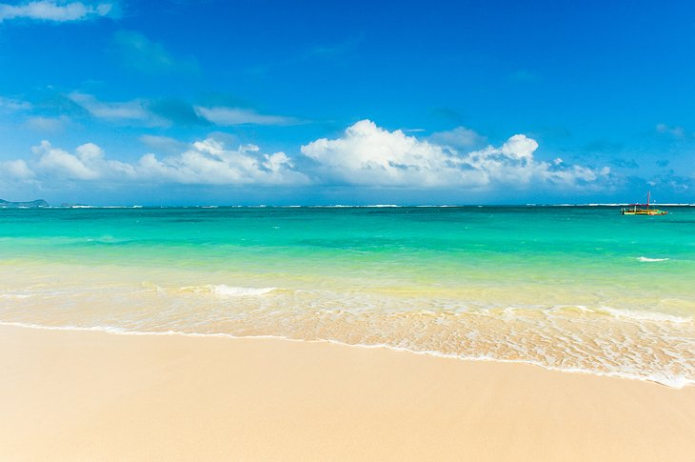
Problem with histograms
It only gives similarity in terms of distribution
It does not give similarity in terms of perception for us humans
So… these images may be similar for this technique

Slide 31
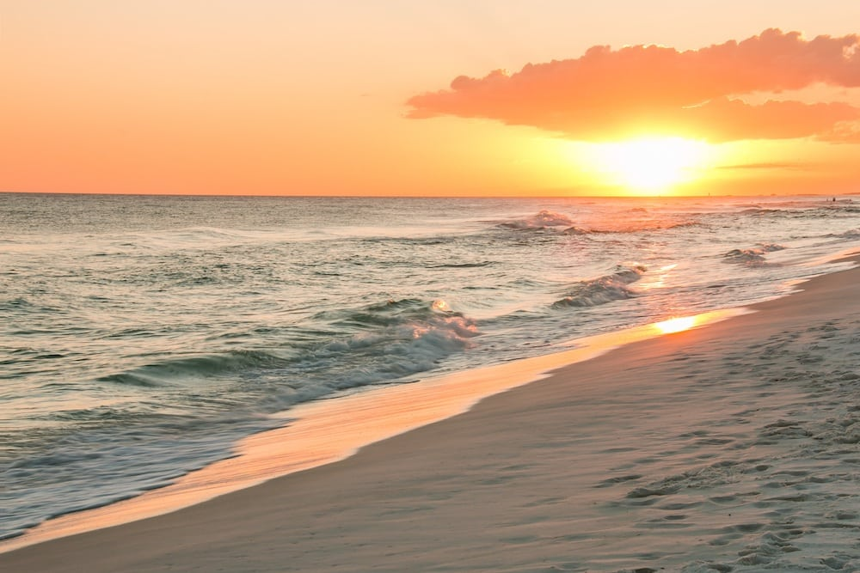
Problem with histograms
It only gives similarity in terms of distribution
It does not give similarity in terms of perception for us humans
But not these

Slide 32
Sample Similar Code
b1 = imread(“b1.jpg");
b2 = imread(“b2.jpg");
b1 = imresize(b1, [200, 200]);
b2 = imresize(b2, [200, 200]);
D = corr2(b1, b2);

Slide 33
Kernel
Sometimes called the convolution matrix or mask.
A small matrix that is used to a digital image through the process of convolution to apply the following:
  Sharpen an image
  Blur an image
  Edge Detection

Slide 34

Convolution
The process of adding each element of the image to its local neighbors, weighted by the kernel.
Very similar to mathematical convolution.
The idea here is that by applying this process to every part of the matrix, we can transform
Example:
$$\sum_{k=1}^{m}{\sum_{l=1}^{n}{I\left(i+k−1,j+l −1\right)K(k,l)}}$$

Slide 35
1 | 2 | 1
0 | 0 | 0
-1 | -2 | -1
1 | 2 | 3
4 | 5 | 6
7 | 8 | 9

Slide 36
-1 | -2 | -1
0 | 0 | 0
1 | 2 | 1
1 | 2 | 3
4 | 5 | 6
7 | 8 | 9

Slide 37
X
-1 | -2 | -1
0 | 0 | 0
1 | 2 | 1
1 | 2 | 3
4 | 5 | 6
7 | 8 | 9

Slide 38
 | X
-1 | -2 | -1
0 | 0 | 0
1 | 2 | 1
1 | 2 | 3
4 | 5 | 6
7 | 8 | 9

Slide 39
 |  | X
-1 | -2 | -1
0 | 0 | 0
1 | 2 | 1
1 | 2 | 3
4 | 5 | 6
7 | 8 | 9

Slide 40
X
-1 | -2 | -1
0 | 0 | 0
1 | 2 | 1
1 | 2 | 3
4 | 5 | 6
7 | 8 | 9

Slide 41
 | X
1 | 2 | 3
4 | 5 | 6
7 | 8 | 9
-1 | -2 | -1
0 | 0 | 0
1 | 2 | 1

Slide 42
Convolution In DEMO
(0 * -1) + ( 0 * -2 ) + ( 0 * - 1) +
(0 * 0) + ( 1 * 0 ) + ( 2 * 0 ) +
(1 * 0) + ( 4 * 2 ) + (5 * 1 ) = 13
-1 | -2 | -1
0 | 0 | 0
1 | 2 | 1
1 | 2 | 3
4 | 5 | 6
7 | 8 | 9
13

Slide 43
Convolution In DEMO
(0 * -1) + ( 0 * -2 ) + ( 0 * - 1) +
(1 * 0) + ( 2 * 0 ) + ( 3 * 0 ) +
(4 * 1) + ( 5 * 2 ) + (6 * 1 ) = 20
-1 | -2 | -1
0 | 0 | 0
1 | 2 | 1
1 | 2 | 3
4 | 5 | 6
7 | 8 | 9
13 | 20

Slide 44
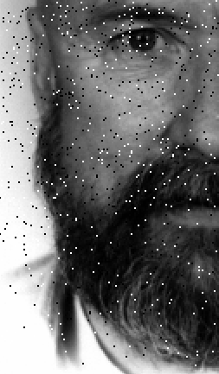
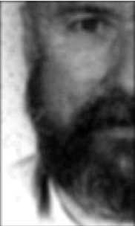

Why does this matter?
$\frac{1}{16}\left[\begin{matrix}1 & 2 & 1 \\ 2 & 4 & 2 \\ 1 & 2 & 1\end{matrix}\right]$ x =
3x3 Approx
Gaussian Kernel

Slide 45
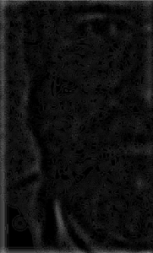

Why does this matter?
$\left[\begin{matrix}−1 & −1 & −1 \\ −1 & 8 & −1 \\ −1 & −1 & −1\end{matrix}\right]$ x =
Laplasian Kernel

Slide 46
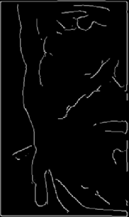

Why does this matter?
$Canny Edge$
Detection

Slide 47
Sample Octave Code
pkg load image;
lena = imread("imgwnoise.bmp");
gaussian = [ 1 2 1 ; 2 4 2 ; 1 2 1 ] * (1/16);
gaussian_shortcut = fspecial('gaussian', [32, 32], 6);
lena_blur = imfilter(lena, gaussian_shortcut);
lap_filter = [-1 -1 -1; -1 8 -1; -1 -1 -1];
lena_sharp = lena_blur;
lena_edge = imfilter(lena_sharp, lap_filter);
lena_edge = edge(lena_sharp, "canny");
subplot(1, 2, 1);
imshow(lena_blur);
subplot(1, 2, 2);
imshow(imfilter(lena_edge * 1, gaussian));

Slide 48
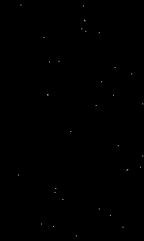
Obtaining the End points

Slide 49
Sample octave code
lena_edge = edge(lena_sharp, "canny");
skeleton = [1 1 1; 1 10 1; 1 1 1];
lena_binary = lena_edge != 0;
lena_binary = uint8(lena_binary);
lena_dilute = imfilter(lena_binary, skeleton);
point = lena_dilute == 11;
point = point * 255;

Slide 50
Create a statistical model for the coordinates of the end points?

Slide 51
Combine it with another statistical model for color distribution?

Slide 52
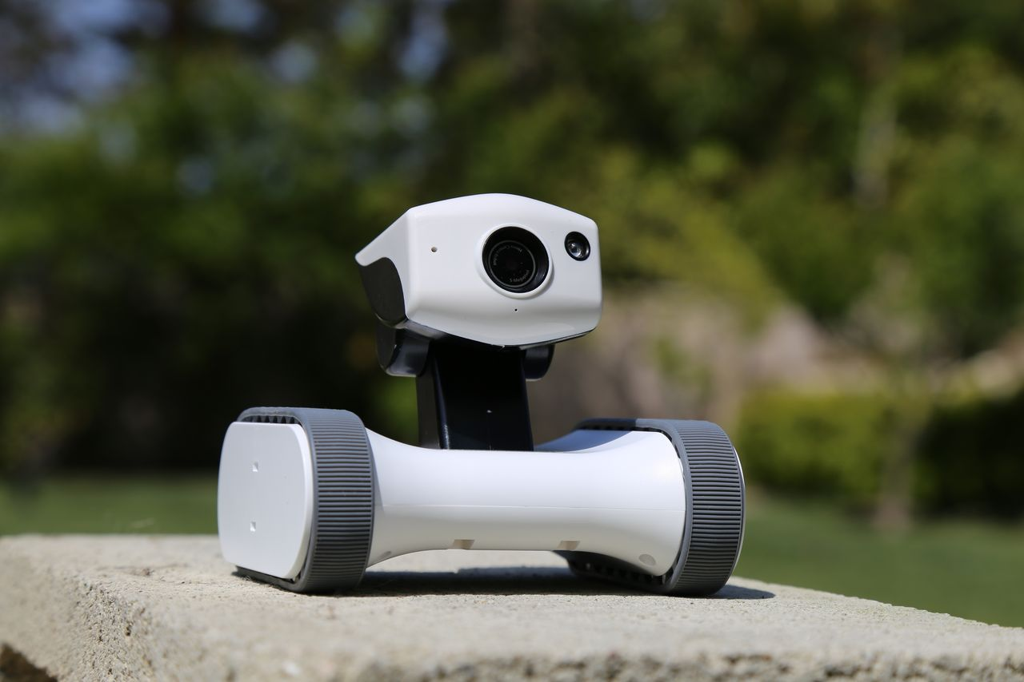

Thank You
Email
richard@richardorilla.website
Offline Copy
http://www.richardorilla.website/copy/usep-presentation-image-intro.pptx
http://www.richardorilla.website/copy/usep-presentation-image-intro.odp

